Slide 1

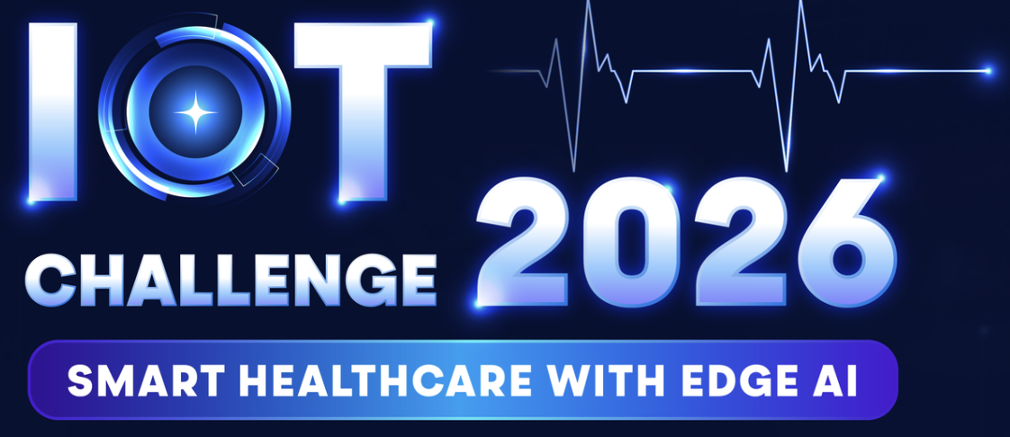
SomniGuard: Edge AI-Powered Closed-Loop Sleep Apnea Detection & Tactile Intervention System
Fantastic Five
May 7, 2026

Slide 2

Table content
Content
1. Introduction
2.Objective
3.System Diagram
4.Resource Allocation
5.Project Milestones
6.Work Process
7.Risk Management & Additional Info

Slide 3

Introduction
Team Name: Fantastic Five
Team Motto: Follow Your Every Dream
Team Size: 5
Team Lead Name: Mai Xuân Nhựt
Team Members (5)
Name: Lê Đức Tài
University: HCMUT
Course and Year Group: Computer Engineering (3rd year)
Contact Email: ldtai061205@gmail.com
Discord Handle: Fantastic Five - Tài
Name: Mai Xuân Nhựt
University: HCMUT
Course and Year Group: Computer Engineering (3rd year)
Contact Email: nhutmai0515@gmail.com
Discord Handle:
Name: Lâm Nguơn Hiếu Trung
University: UMP
Course and Year Group: General Doctor (3rd year)
Contact Email: hieutrung4098@gmail.com
Discord Handle:
Name: Nguyễn Thái Sơn
University: HCMUT
Course and Year Group: Computer Engineering (3rd year)
Contact Email: nguyenthaison25052005@gmail.com
Discord Handle: thaison336
Name: Nguyễn Thái Học
University: HCMUT
Course and Year Group:Computer Science (3rd year)
Contact Email: hoc.nguyen2311100@hcmut.edu.vn
Discord Handle:

Slide 4
Objective
Problem Statement
Sleep apnea and arrhythmias are life-threatening.
Traditional monitoring lacks scalability and widespread adoption.
Current wearables only monitor but not guarantee to intervene in real-time during critical events due to cloud processing latency.
Solution
Smart Sensing: Fuses PPG and IMU data to filter motion artifacts.
Local Edge AI: Runs model AI directly on-device for ultra-low latency detection.
Active Intervention: Triggers instant haptic motor alerts to shift user posture.
Core Values: Ensures strict data privacy and 100% offline reliability.
Ultra-low Power Tracking: Ensure at least 12 hours of continuous operation on a single charge to cover a full sleep cycle thanks to utilizing MCU Deep Sleep Mode.

Slide 5
Objective
User Flow

Slide 6
System Diagram

Slide 7
System Diagram
Components and Interfaces
Highlight Wireless Technology and Edge AI solution

Slide 8
Resource Allocation
Human resources (assigned roles based on experience and expertise):
  Mai Xuân Nhựt: IoT System Integration
    Responsibilities: Overall project management & Agile tracking. Developing the Layer 2 Local Edge Gateway on Raspberry Pi 4B (Python/Node.js). Setting up the Layer 3 Cloud Analytics via MQTT protocol and ThingsBoard/Grafana dashboard.
  Nguyễn Thái Học: Lead AI/ML Engineer
    Responsibilities: Handling Data Pre-processing, Sensor Fusion datasets, and Model Training. Designing the 1D-CNN Edge AI architecture as baseline, potentially applying more advanced method to capture longer-dependency and deal with resource-constraint. he model for TensorFlow Lite for Applying Quantization methods to optimize Microcontrollers. Apply personalized model and dynamic sampling rate after anomaly
  Nguyễn Thái Sơn: Hardware & Communications Engineer
    Responsibilities: Designing the wearable hardware schematics and sensor node interfaces (I2C/SPI for MAX30102, MPU6050, Thermistor). Implementing and optimizing the low-latency BLE 5.3 communication protocol to transmit Alert Flags to the Gateway.
  Lê Đức Tài: Embedded Firmware Engineer
    Responsibilities: Programming the core Silicon Labs EFR32xG26 Wireless SoC. Designing the Event-driven Finite State Machine (FSM). Implementing critical Power Management strategies (EM2 Deep Sleep & Wake-on-motion) and executing the on-chip AI inference.
  Lâm Nguơn Hiếu Trung: Medical Advisor
    Responsibilities: Defining accurate medical thresholds for Sleep Apnea and Arrhythmia based on PPG/IMU data. Designing the haptic intervention logic to ensure patient safety and optimal User Experience (UX) during sleep. Validating the system's output against clinical logic.

Slide 9
Resource Allocation
Equipment and tools
  Hardware: EFR32xG26 Dev Kit, Raspberry Pi 4B,
    MAX30102: sensor to collect PPG data.
    MPU6050: sensor to collect IMU data.
  Software: Simplicity Studio v5, TensorFlow Lite for Microcontrollers, Silicon Labs GitHub Sandbox.

Slide 10
Project Milestones
Assembly
DSP Implementation
Data Pipeline.
BLE Integration,
MQTT Dashboard Setup.
Hardware & Data
May 23 - Jun 15
Gateway & Cloud
Jul 16 - Aug 10
2
4
1
Edge AI & Firmware
Jun 16 - Jul 15
3
Testing & Demo
Aug 11 - Aug 24
Model Training (Quantization)
Chip AI Deployment.
Power Optimization
Video Demo Prep.

Slide 11
Work process
Team Meetings: Bi-weekly technical syncs via Google Meet.
Progress Tracking: Agile methodology using Trello/Jira boards.
Collaboration Methods: Strict usage of the official Silicon Labs GitHub Sandbox for all source code version control.
Interaction with Mentors: Weekly code reviews and Simplicity Studio debugging sessions via Discord.

Slide 12
Risk Management
Risk 1: AI model exceeds limited RAM of EFR32xG26.
  Mitigation: Apply Post-Training Quantization (INT8) or Quantization-Ware training and network pruning to fit MCU constraints.
Risk 2: False alarms due to random hand movements during sleep.
  Mitigation: Sensor Fusion algorithm. High IMU acceleration instructs the AI to ignore SpO2 drops as 'Motion Artifacts'.
Risk 3: System battery drains rapidly (<8 hours) due to continuous raw data transmission via BLE and constant AI inferencing.
  Mitigation: Implement Edge Computing architecture. The MCU operates in EM2 Deep Sleep mode. BLE only transmits "Alert Flags" (not raw data). Sensors use low-power sampling rates (IMU 25Hz, PPG 50Hz)
Risk 4: Hardware constraints or unavailable specific sensors during development.

Slide 13



Human & Business Impact
Additional information
Saving Lives
Privacy-First
Economic Value
Ecosystem Expand
Immediate intervention reduces risks of cardiac arrest by forcing posture changes during apnea.
100% Offline Edge processing ensures sensitive medical data never leaves the patient's room.
90% cheaper than Polysomnography (PSG) tests, making quality care accessible to everyone.
Transforms the local node into a scalable, multi-device healthcare network.

Slide 14


Slide 15
SomniGuard: Edge AI-Powered Closed-Loop Sleep Apnea Detection & Tactile Intervention System
Fantastic Five
May 7, 2026

Slide 16
Table content
Content
1. Introduction
3.System Diagram
2.Objective
4.Resource Allocation
3.Somniguard Solution
6.Work Process
4.System Architecture
7.Risk Management & Additional Info
5.Edge AI & DSP Engineering
6.Hierachical FSM & Graduated Intervention
5.Project Milestones

Slide 17
Objective
Problem
Clinical Foundation

Slide 18
Objective
Problem & Clinical Foundation

Slide 19
SomniGuard Solution

Slide 20
System Architecture

Slide 21
Edge AI
& DSP Engineering
Edge AI
DSP Engineering

Slide 22
Edge AI
& DSP Engineering
Edge AI

Slide 23
Edge AI
& DSP Engineering
DSP Engineering

Slide 24
Hierarchical FSM
& Graduated Intervention

Slide 25
Accuracy Benchmark
& Clinical Validation

Slide 26
BLE Ecosystem
& Customizability

Slide 27
Power Budget & Impact

Slide 28
Project Roadmap
& Next Steps to Final

Slide 29
Summary & Q&A

Slide 30
User Flow

